Slide 1
Inheritance

Slide 2
Objectives
Study concepts: superclass, subclass
Understand the “is-a” relationship
Functions in inheritance
Using an “instanceof” operator

Slide 3
Implementing Object-Oriented Relationships
3 common relations in classes:
“is a/ a kind of”
“has a”
association
Examples:
Student is a person
“A home is a house that has a family and a pet.”
An invoice contains some products and a product can be contained in some invoices

Slide 4
Implementing Object-Oriented Relationships…
The relation “is a” is implemented as a sub-class
Person
String name, address String birthDate
+ String getName(); + void setName(String n);
…….
The relation “has a” is implemented as reference
Classes Professor, Student are sub-classes of the class Person
Sub-classes inherit the structure of super class
is a
is a
Professor
String department
+ String getDepartment(); + void setDepartment(String d);
Student
String studentId, majorField String degreeSought
+ String getStudentId(); + void setStudentID(String id)
….
teach
The class Professor has the field Student[] students
The class Student has the field Professor pr

Slide 5
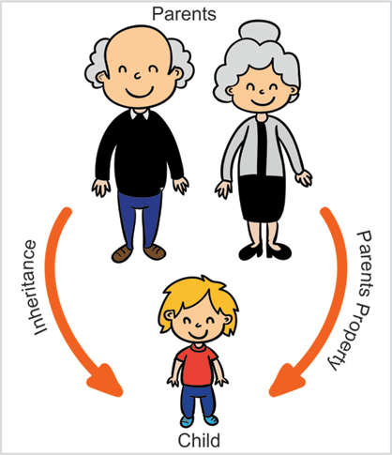
Source: https://medium.com/@rashadsh/inheritance-in-oop-everything-you-need-to-know-822125fe9169

Slide 6
Inheritance
Inheritance: is a mechanism in which a child object acquires the properties and behavior of a parent object. It is an important part of OOPs (Object Oriented Programming).
The idea: you can create new classes that are built on top of existing classes. When you inherit from an existing class, you can reuse the methods and fields of the super class. You can also add new methods and fields to your existing class.

Slide 7
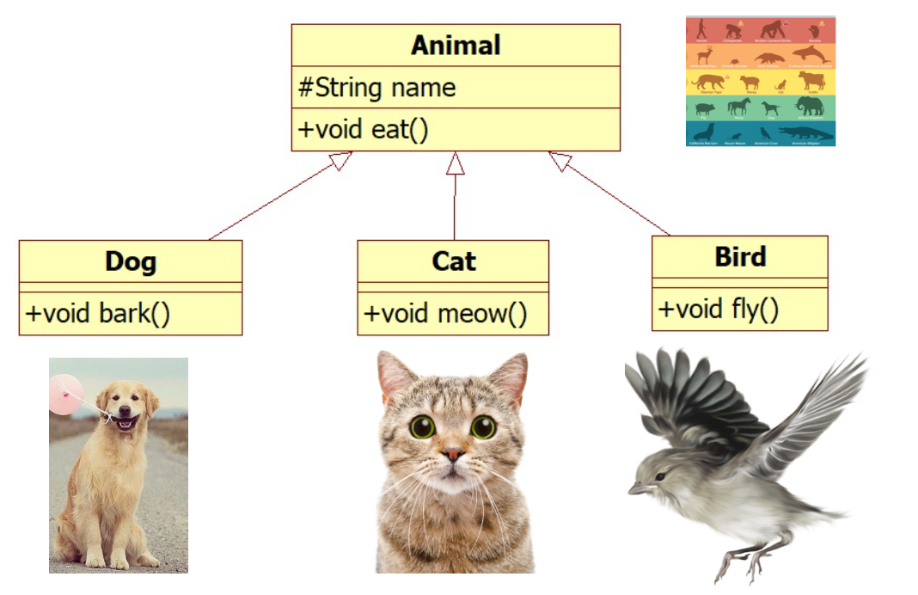
Inheritance

Slide 8
Inheritance
There are some sub-classes from one super class ➔ An inheritance is a relationship where objects share a common structure: the structure of one object is a sub-structure of another object.
A class can be directly derived from only one class ( Java is a single-inherited OOP language).
If a class does not have any superclass, then it is implicitly derived from Object class.
Unlike other members, constructor cannot be inherited ( constructor of super class can not initialize sub-class objects)
The extends keyword is used to create sub-class.

Slide 9
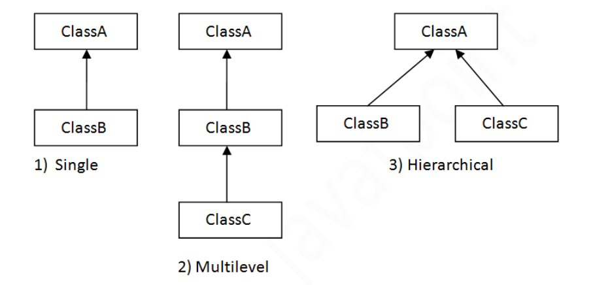
Inheritance

Slide 10
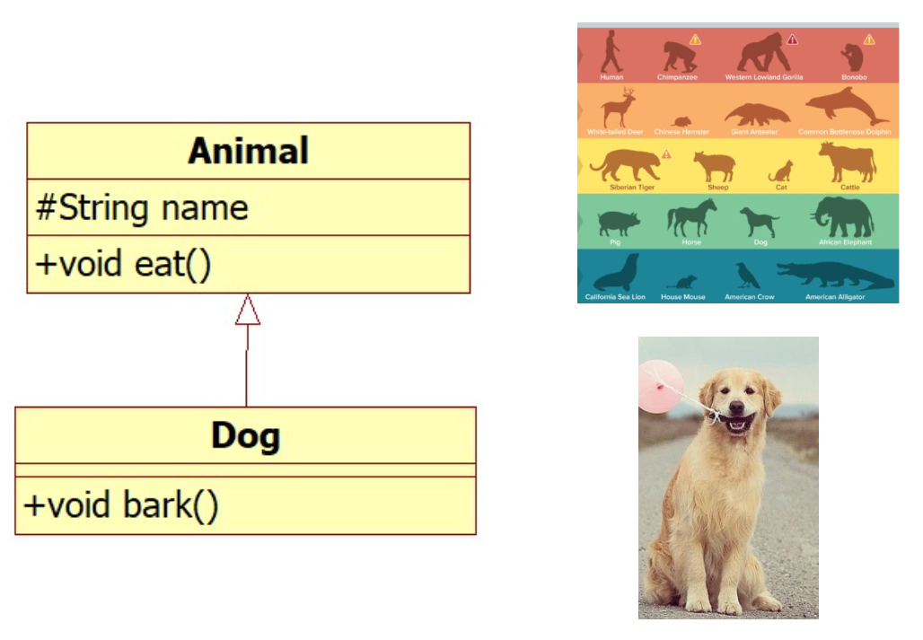
Inheritance

Slide 11
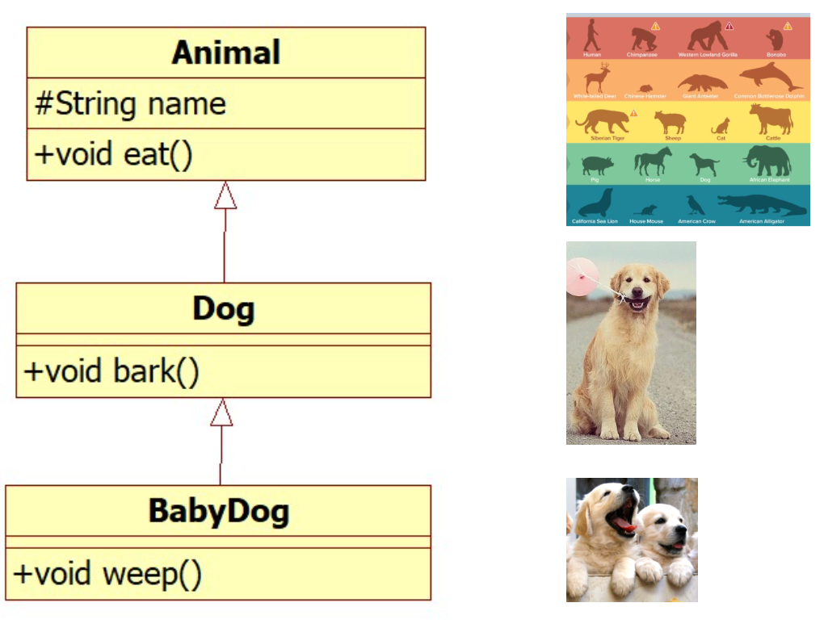
Inheritance

Slide 12
Inheritance

Slide 13
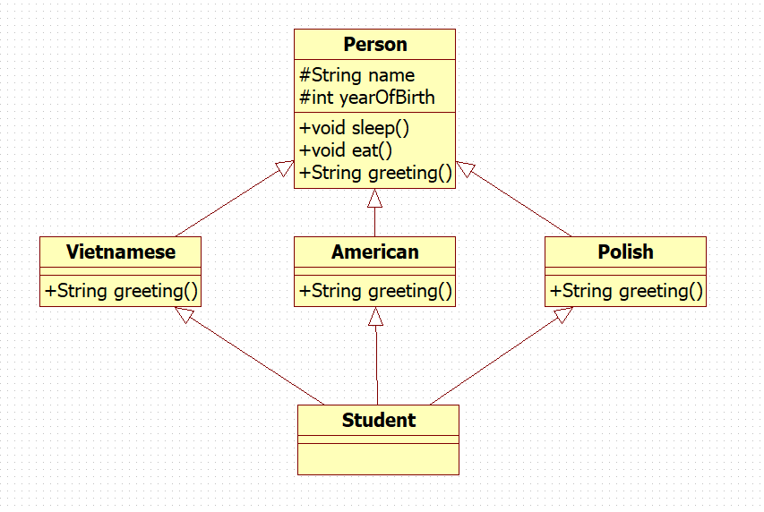

???

Slide 14
Inheritance…
How to construct a class hierarchy? → Intersection
Electric Products< code, name, make, price, guaranty, voltage, power>
Ceramic Products < code, name, make, price, type >
Food Products < code, name, make, price , date, expiredDate >
Product
code
name
make
price
ElectricProduct
Ceramic
Food
guaranty
voltage
power
type
date
expiredDate

Slide 15
Inheritance…: “super” Keyword
Constructors Are Not Inherited
super(...) for Constructor Reuse
super(arguments); //invoke a superclass constructor
The call must be the first statement in the subclass constructor
Replacing the Default Parameterless Constructor
Notes:
always explicitly program a parameterless constructor for a class X any time you program any explicit constructor for class X, to replace the “lost” default constructor.

Slide 16
Inheritance…: “super” Keyword
We use the Java keyword super as the qualifier for a method call: super. methodName(arguments);
Whenever we wish to invoke the version of method methodName that was defined by our superclass.
super() is used to access the superclass's constructor. And It must be the first statement in the constructor of the subclass.

Slide 17
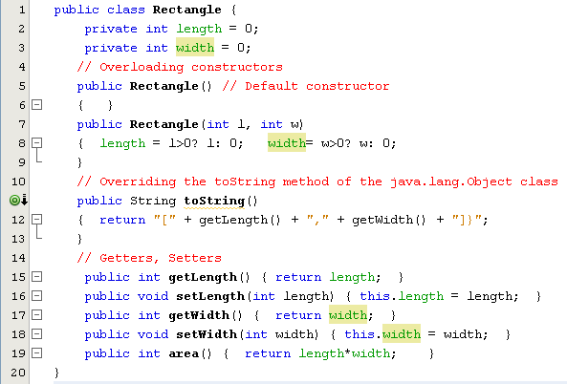
Inheritance…

Slide 18
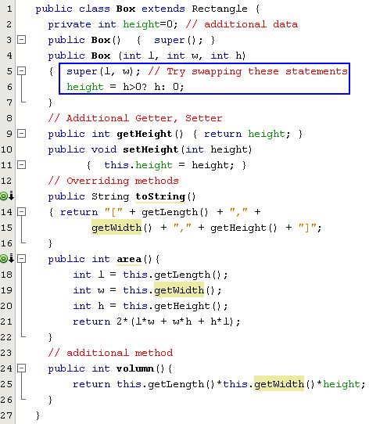
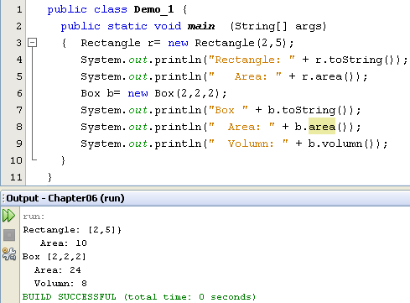
Inheritance…

Slide 19
Overriding and Hiding Methods (1)
Overriding a method: An instance method in a subclass with the same signature (name, plus the number and the type of its parameters) and return type as an instance method in the superclass overrides the superclass's method.
Use the @Override annotation that instructs the compiler that you intend to override a method in the superclass (you may not use it because overriding is the default in Java).
Hiding a method: Re-implementing a static method implemented in super class

Slide 20
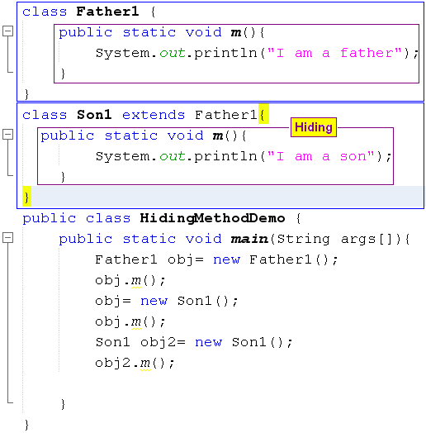

Overriding and Hiding Methods (2)

Slide 21
Using an “instanceof” operator
Dynamic and Static type
dynamic type: A reference variable that has the type of the superclass can store the address of the object of sub class. It is called to be dynamic type, the type that is has at runtime. Rectangle obj1 = new Box();
Static type: The type that it has when first declared. Static type checking is enforced by the compiler. Box obj2 = new Box();
“Instanceof” operator: It checks whether the reference of an object belongs to the provided type or not, the instanceof operator will return true or false. If ( obj1 instanceof Box) System.out.println(“ obj1 is pointing to the Box object”);

Slide 22
Casting
A variable that has the type of the superclass only calls methods of the superclass. To call methods of the subclass we must cast explicitly
for example,
Rectangle obj = new Box(); ((Box)obj).setHeight(300);

Slide 23
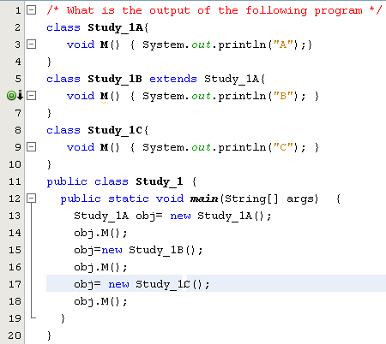
Test
a) ABC
b) AAC
c) ABA
d) Compile-time error
Study_1A and Study_1C are inconvertible

Slide 24
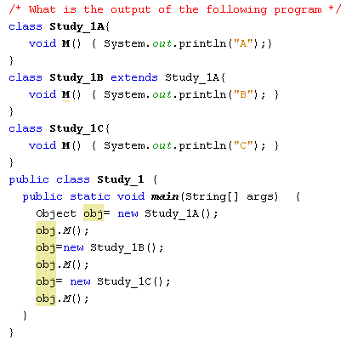
Test
a) ABC
b) AAC
c) ABA
d) Compile-time error
The java.lang.Object class does not have the M() method

Slide 25
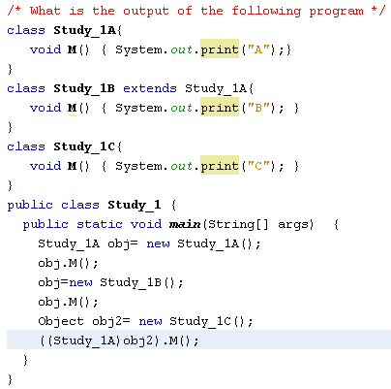
Test
a) ABC
b) AAA
c) ABA
d) None of the others
AB and a ClassCastException

Slide 26
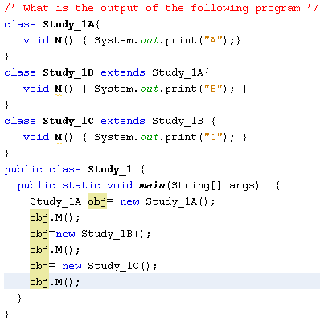
Test
a) AAA
b) ACB
c) None of the others
d) ABC

Slide 27
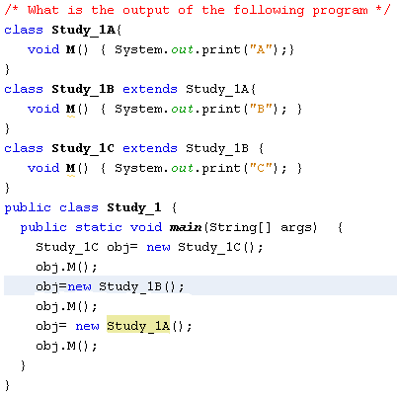
Test
a) ABC
b) AAA
c) ABA
d) None of the others
Compile-time error
( Type conformity violation)

Slide 28
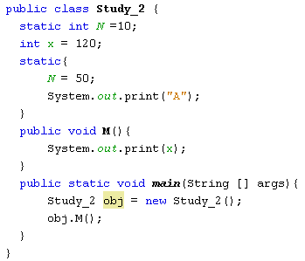
Test
a) 120
b) 120A
c) None of the others
d) A120

Slide 29
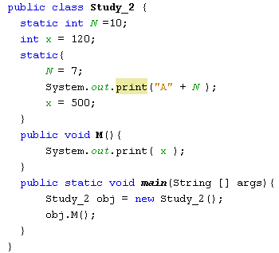
Test
a) A7500
b) 500A7
c) 500
d) None of the others
Compile-time error
( static code can not access instance variables)

Slide 30
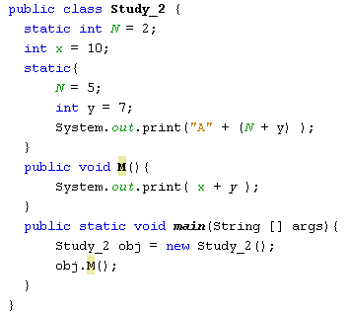
Test
a) A1210
b) 10A12
c) 17
d) None of the others
Compile-time error
( The y variable is out of scope)

Slide 31
Summary
Object-oriented languages implement reusability of coding structure through inheritance
A derived class does not by default inherit the constructor of a super class
Constructors in an inheritance hierarchy execute in order from the super class to the derived class
Using the instanceof keyword if we need to check the type of the reference variable.
Check the type of the reference variable before casting it explicitly.

Slide 32

Self-study at home
Lập trình Java - YouTube

